Slide 1
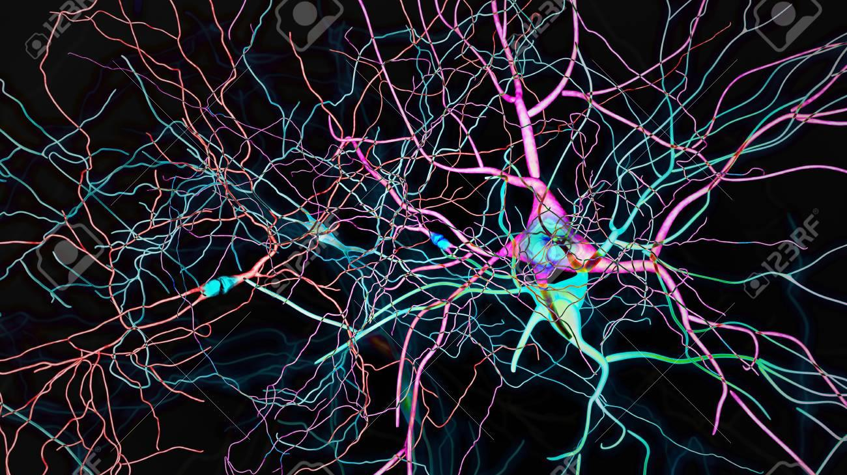
Multi Layer Perceptron and Neural Networks
Risman Adnan Mattotorang, Ph.D
Samsung R&D Indonesia
Telkom University

Slide 2

Outline
Understanding Problem
How Neural Network Works
Error / Loss Function
Back Propagation Algorithm
Heuristic Training Dynamic
Implementation
Q&A

Slide 3
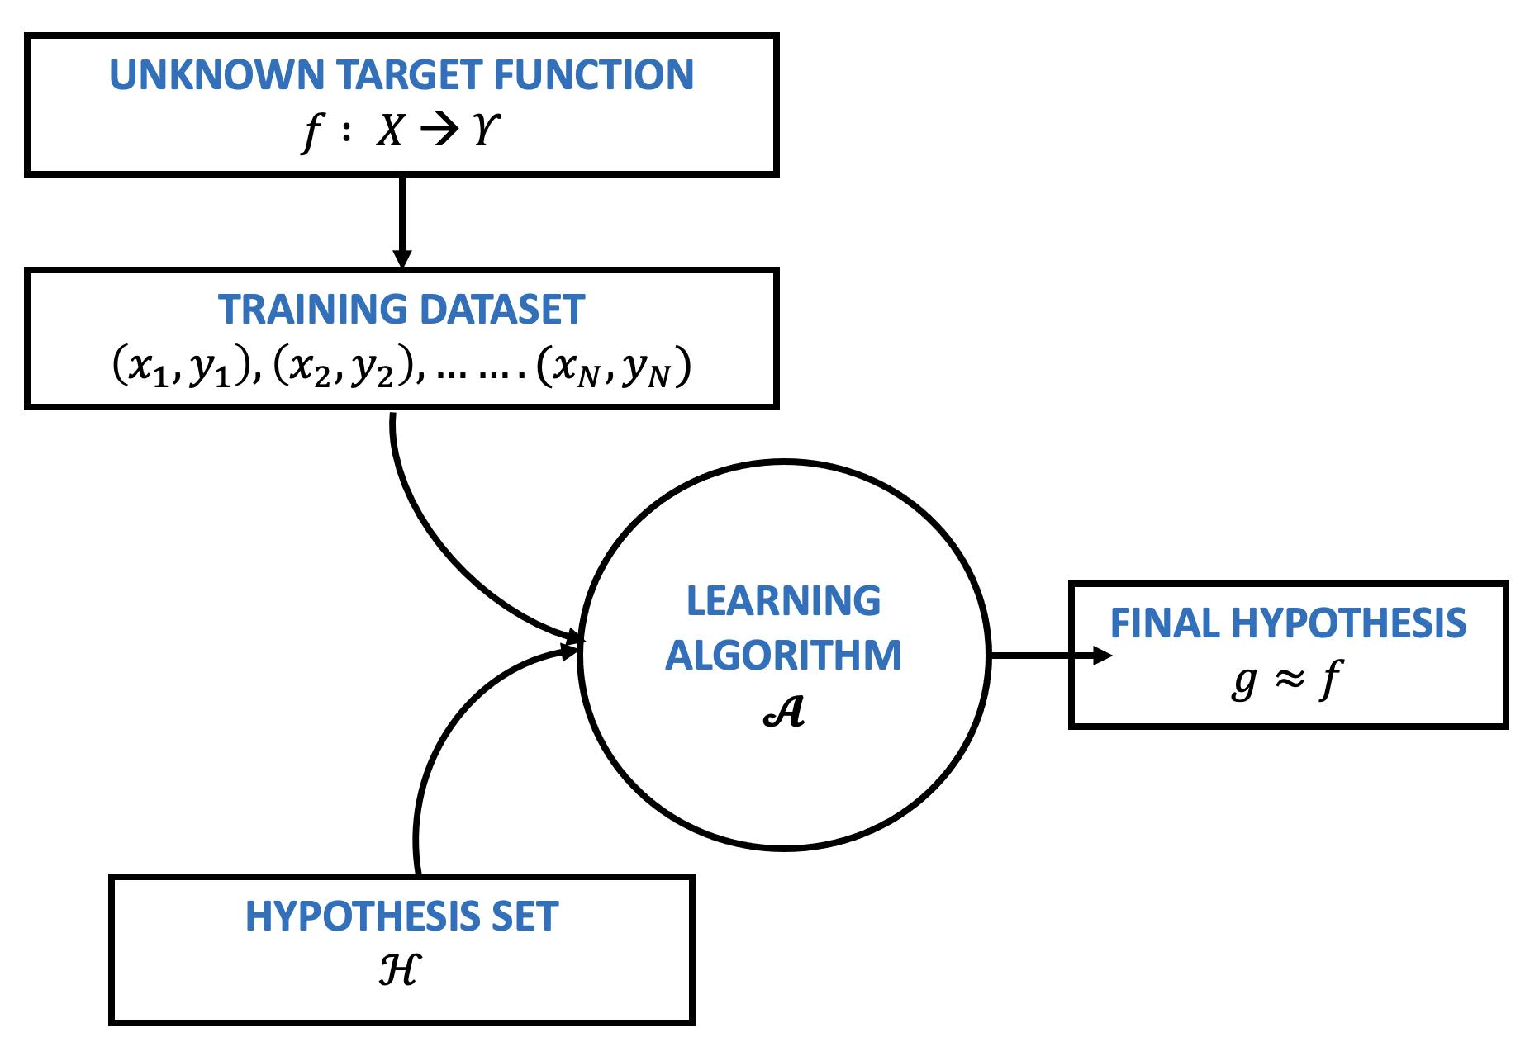




Thinking Framework – Supervised Learning
Error / Loss / Distance
The data that we can learn from.
A model of how to transform the data.
MODEL
An objective function that quantifies how well (or badly) the model is doing.
An algorithm to adjust the model’s parameters to optimize the objective function.

Slide 4
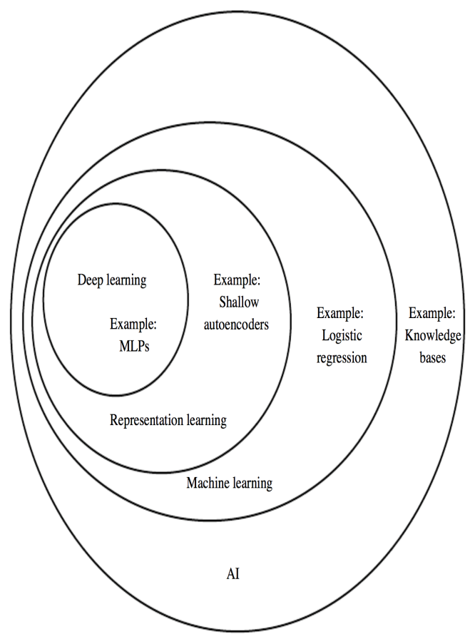
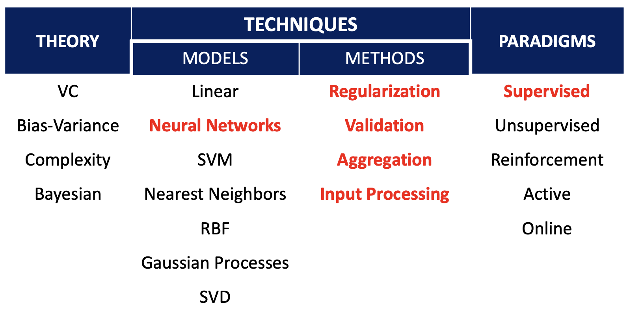
Machine Learning Landscape
Machine learning become a jungle of models and methods!
Notes:
References:
Yoshua Bengio – Deep Learning
Yasser Abu-Mustofa – Learning from Data
Hierarchy of concepts, learn complicated concepts from simpler ones 🡪 if we draw a graph, it should be deep.

Slide 5
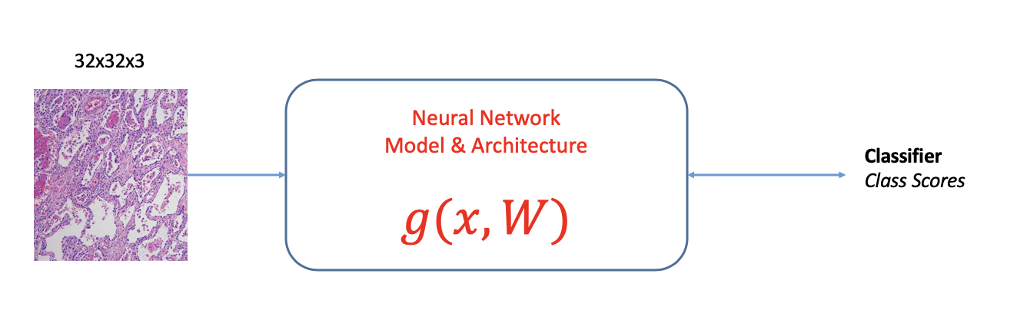
Essence of ML Model
There is Pattern in Data
We Don’t Have Analytical Solution
We Have Data (+Label)

Slide 6
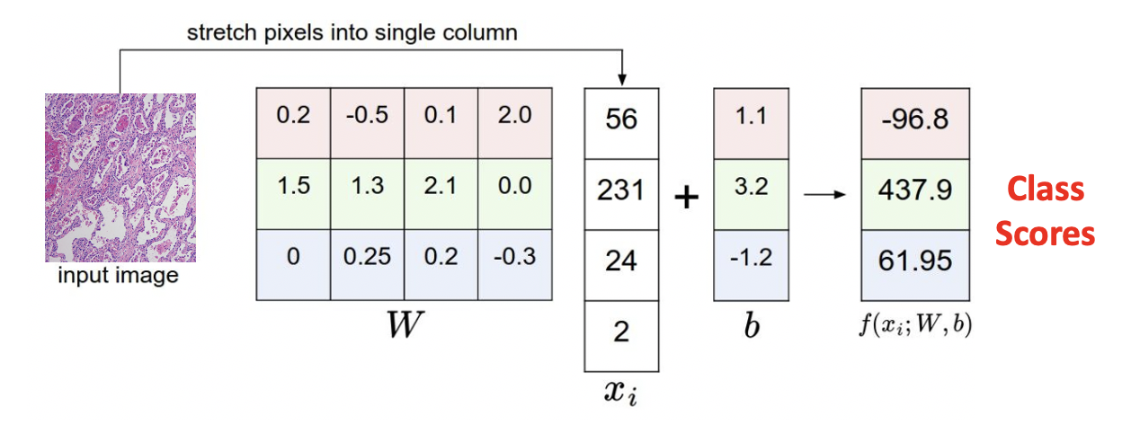
Trained Model
What We Expect
Good Accuracy
Good Generalization
What We Can Do
Inference

Slide 7
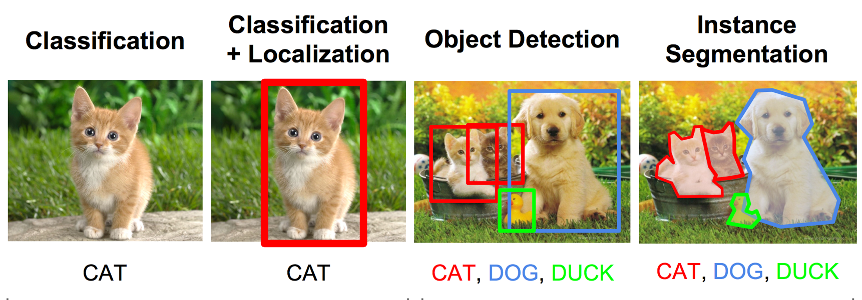
Computer Vision Domain

Slide 8
Outline
Understanding Problem
How Neural Network Works
Error / Loss Function
Back Propagation Algorithm
Heuristic Training Dynamic
Implementation
Q&A

Slide 9
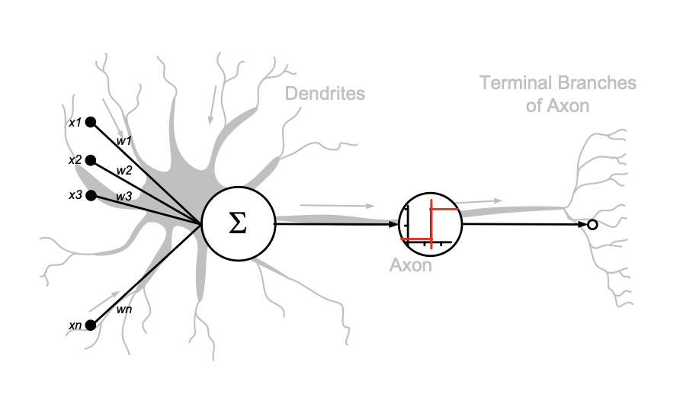
Artificial Neural Networks
Slide credit : Andrew L. Nelson
Notes:
Slide credit : Andrew L. Nelson

Slide 10
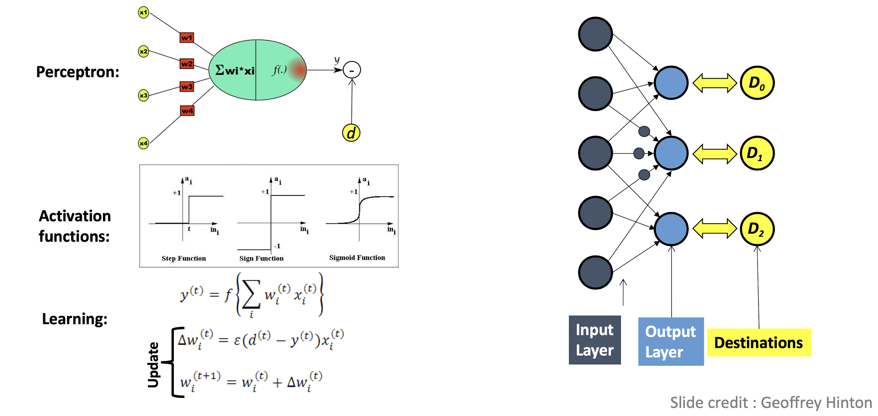
A Simple Model - Perceptron
Key Concepts:
Perceptron
Activation Function
Learning Algorithm

Slide 11
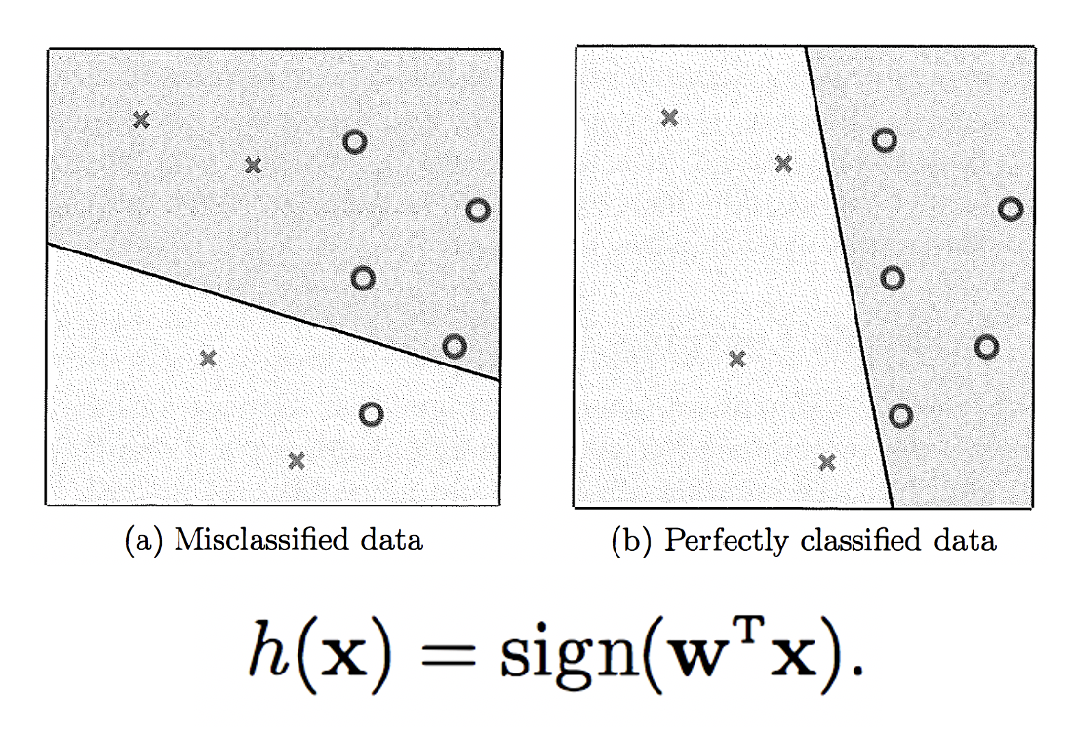
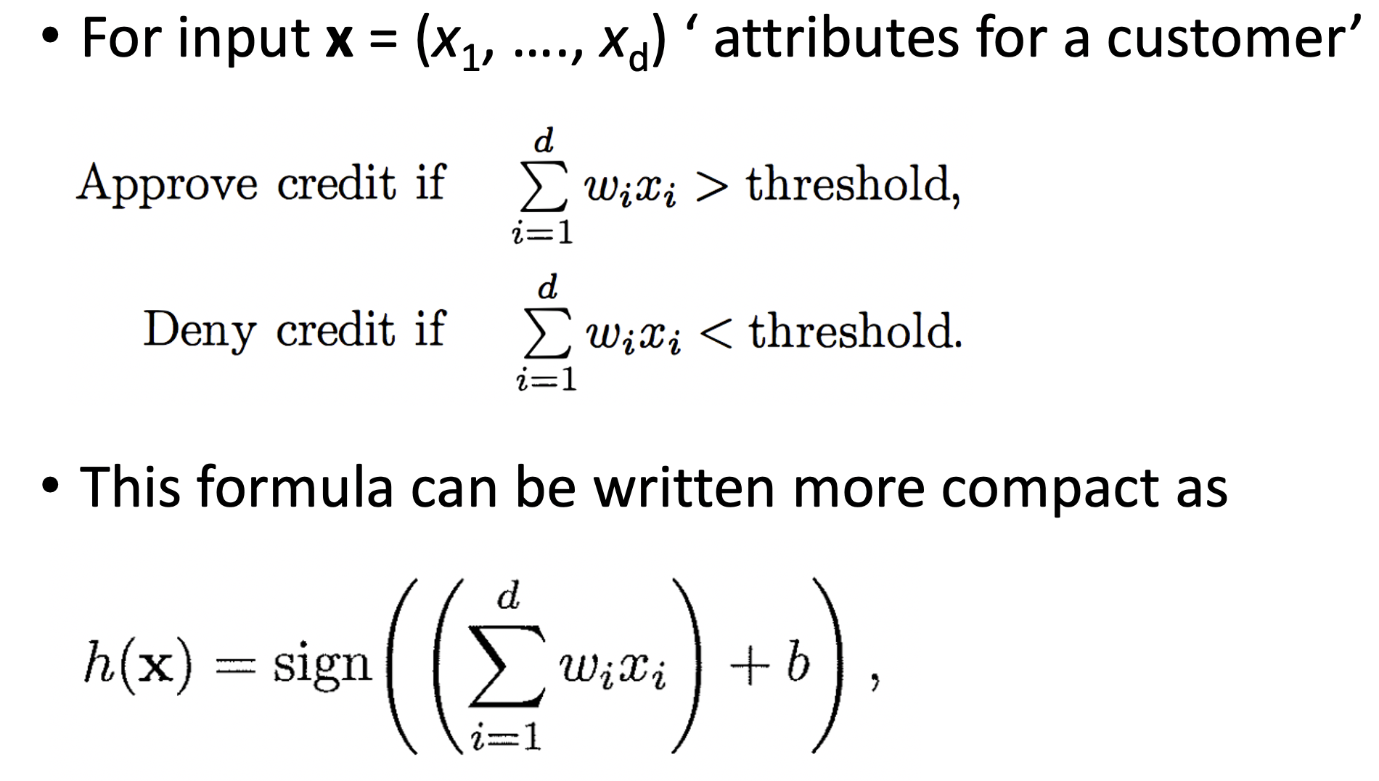
A Simple Hypothesis Set
Simple Threshold Function
Simple Linier Model
Only in Two Dimension

Slide 12
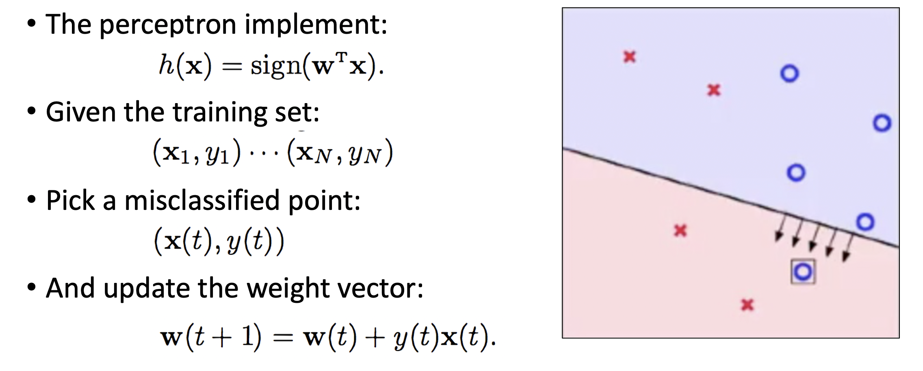
Perceptron Learning Algorithm
Simple Rule to Update Parameters
Iterative Update on Parameters
No Stopping Criteria

Slide 13
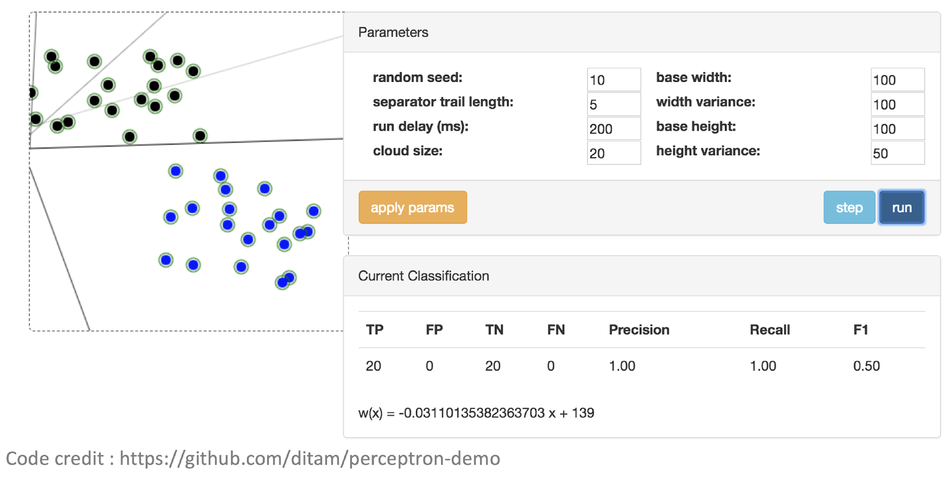
Perceptron Learning Algorithm

Slide 14
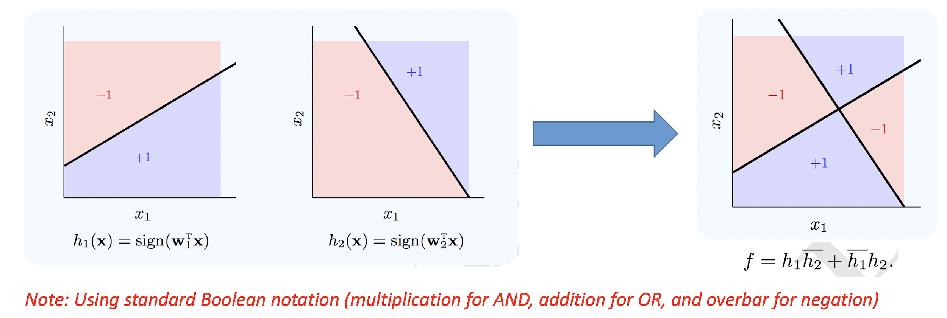
Combining Perceptron
Can perceptron combined to perform more complex target function?
Yes if we can write f using simple AND and OR operations:

Slide 15
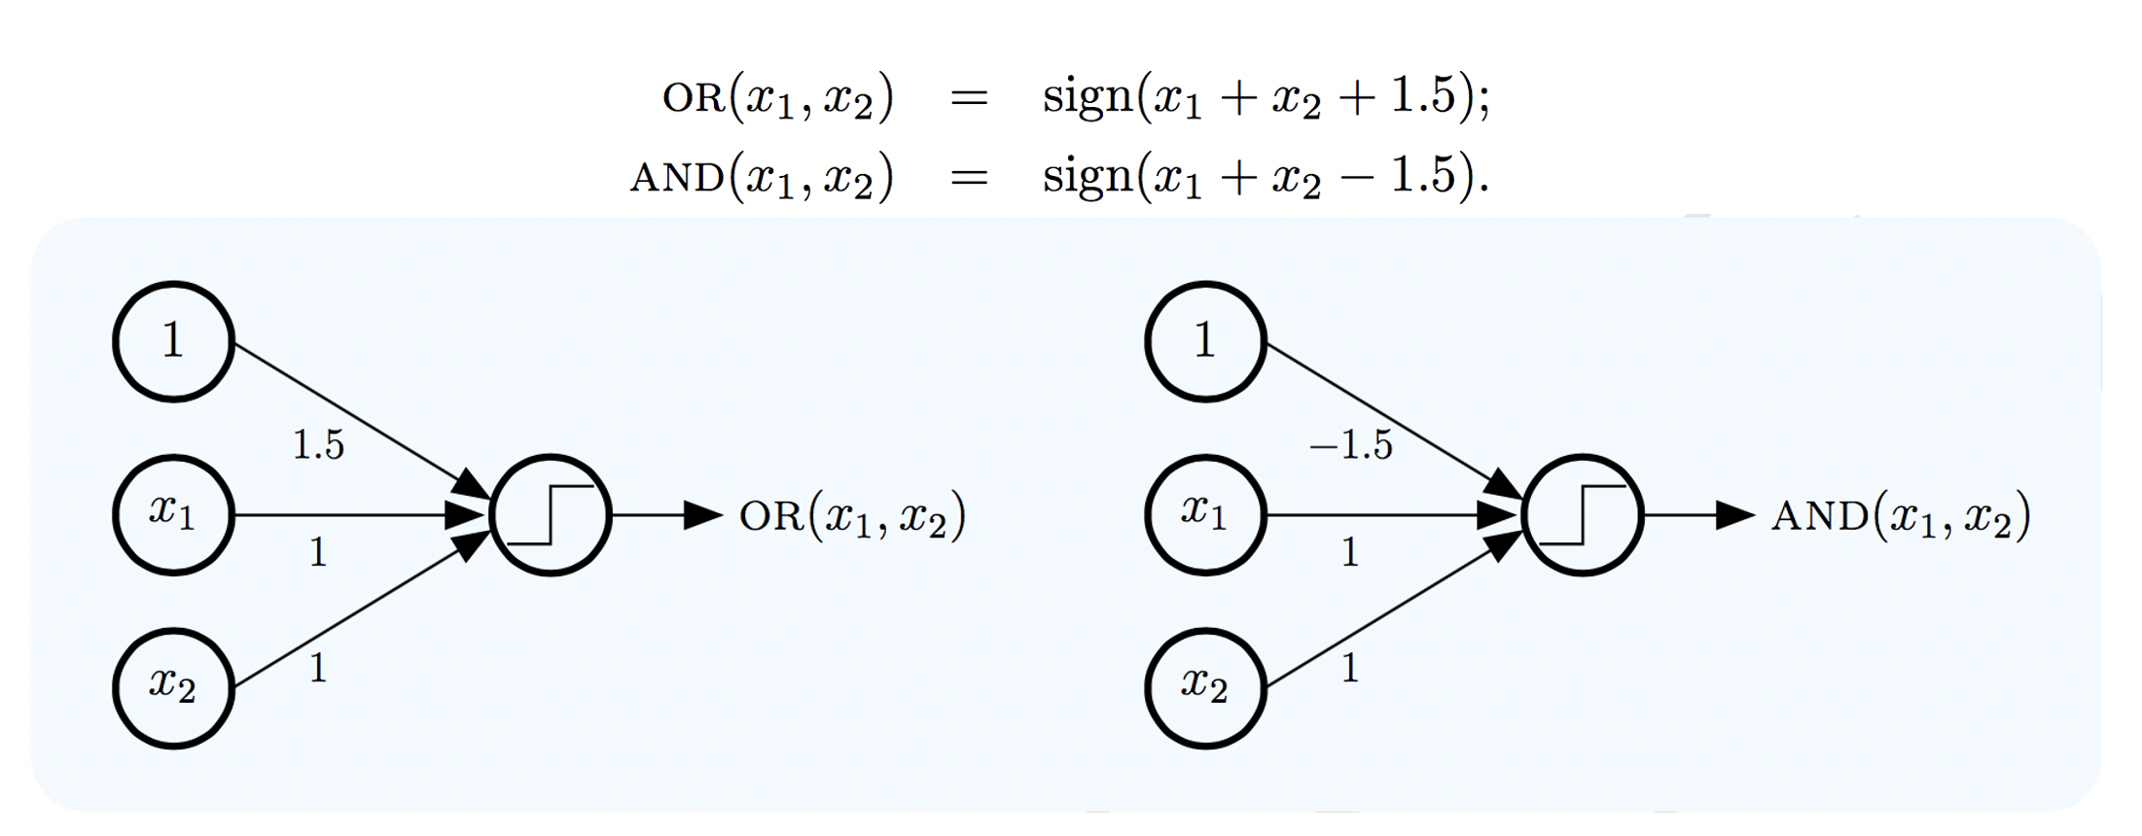
Combining Perceptron
Can perceptron implement AND and OR operation?

Slide 16
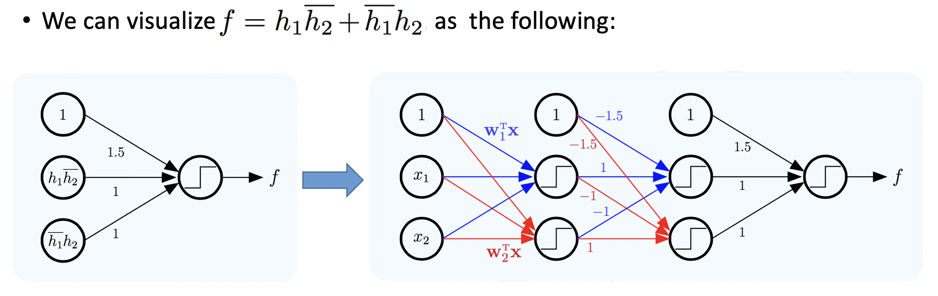
Combining Perceptron
Key Insight: More layers of nodes are used between input and output to implement more complex target function f. We called Multi-Layer Perceptron. Additional layers are called hidden layers.
Notes:
We gained the ability to model more complex target functions by adding more nodes (hidden units) in the hidden layers – this corresponds to allowing more perceptrons in the decomposition of f.

Slide 17
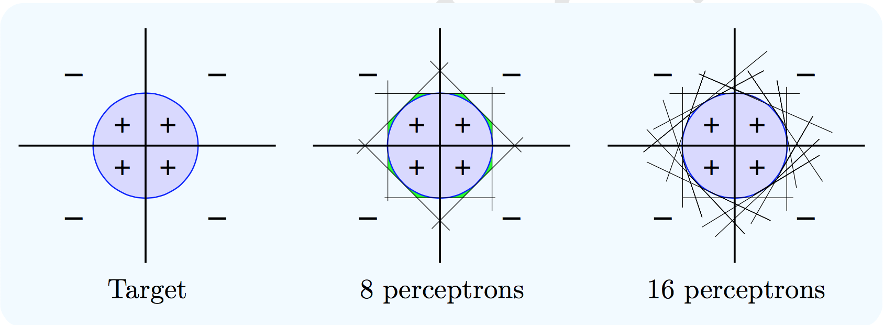
A Powerful Model
If f can be decomposed into perceptrons using an OR of ANDs, then it can be implemented by a 3-layer perceptron. If f is not strictly decomposable into perceptrons, but the decision boundary is smooth, then a 3-layer perceptron can come arbitrarily close to implementing f. Visual Proof:
Notes:
In fact, a suitably large 3-layer MLP can closely approximate just about any target function, and fit any data set, so it is a very powerful learning model. Use it with care. If your MLP is too large you may lose generalization ability.
Once you fix the size of the MLP (number of hidden layers and number of hidden units in each layer), you learn the weights on every link (arrow) by fitting the data.

Slide 18
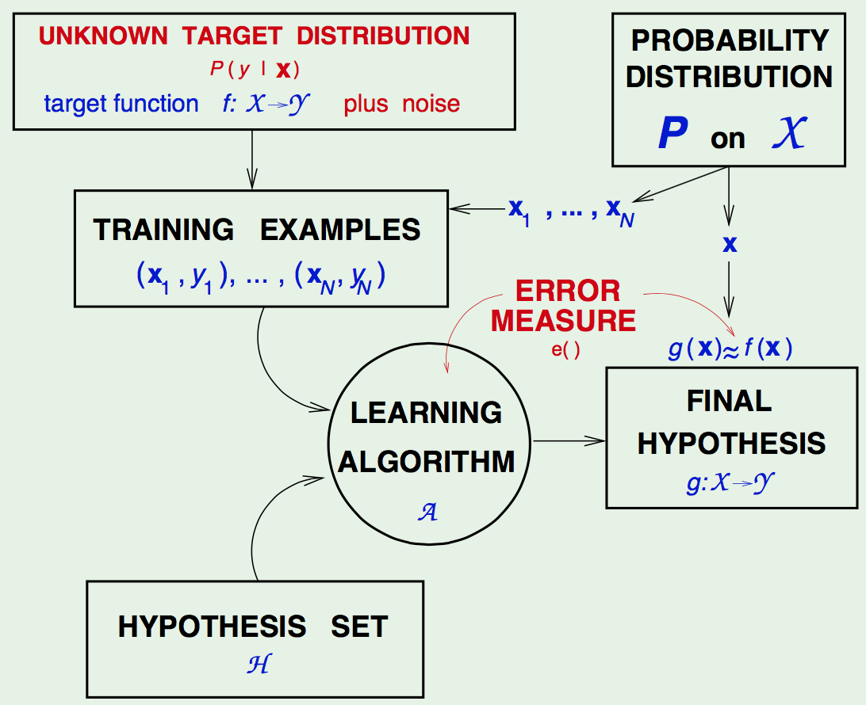
The Learning Framework
How to Learn Weights?
Error or Loss or Cost Function
Optimization Technique
Regularization Technique
Goal: Accuracy & Generalization
Error function quantifying what it means to have a “good” weights.
We have to come up with a way to minimize error/loss.
Two type of error/loss:
In-sample Error E_{in}
Out-of-sample Error E_{out}

Slide 19
Outline
Understanding Problem
How Neural Network Works
Error / Loss Function
Back Propagation Algorithm
Heuristic Training Dynamic
Implementation
Q&A

Slide 20

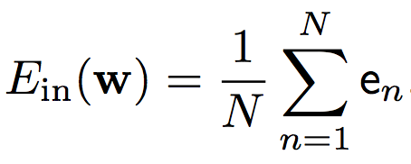
How to Learn the Weights?
Goal: Learning all weights by minimizing error
One Hidden Layer: Simply aggregation of perceptrons.
Deep Neural Networks? Not Easy. Why?
Challenging to Train.
High Model Complexity.
Sophisticated Structural Decisions.
Hard Optimization Problem
Computational Complexity

Slide 21

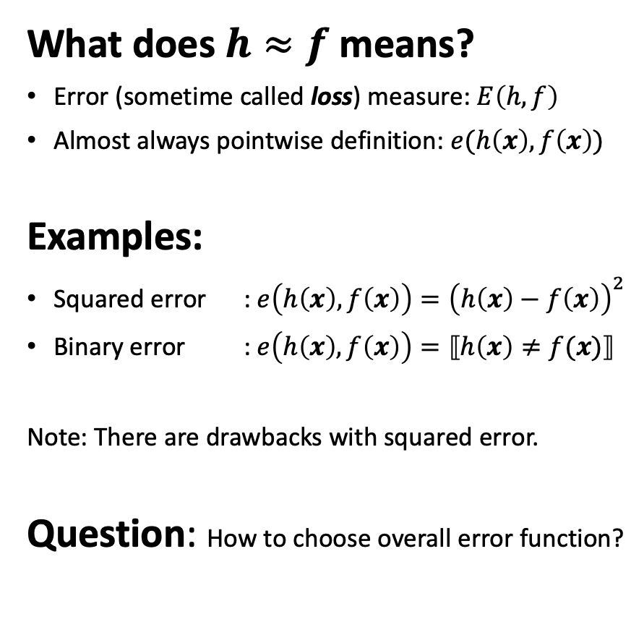
Error Measures

Slide 22
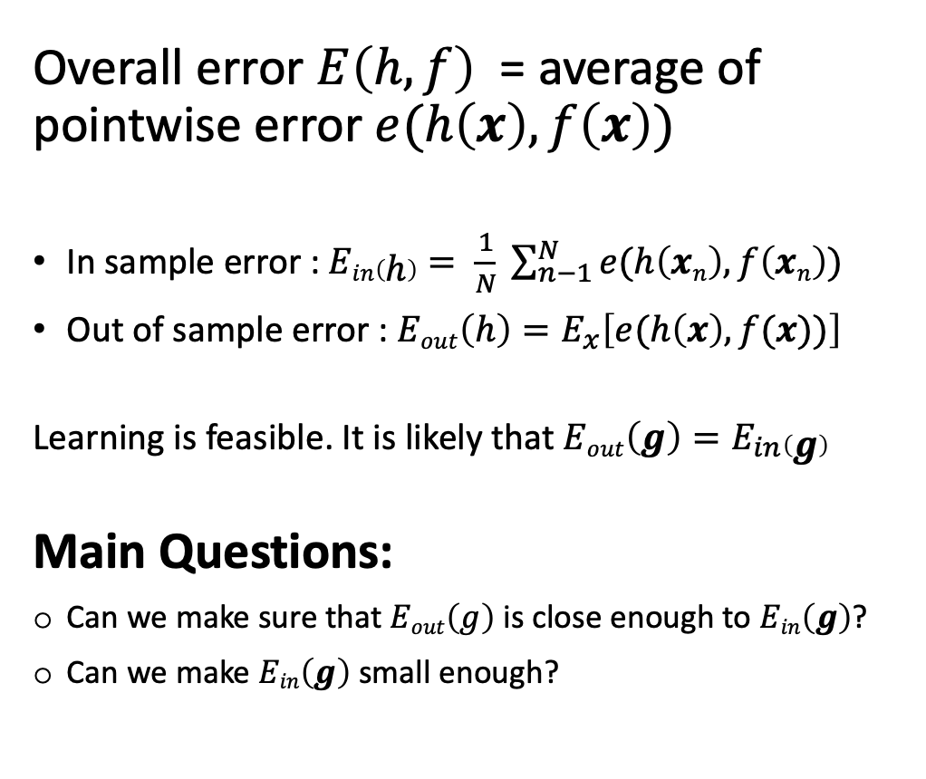
From Pointwise to Overall

Slide 23
How to Choose Error Function
More or less same with other parametric models.
The squared error measure has some drawbacks.
Question: Is there a different error function that works better?
Yes: Use SVM classifier or force the outputs to represent a probability distribution across discrete alternatives.
We will learn the following:
Multiclass SVM Loss
Softmax Classifier
Notes:
The squared error measure has some drawbacks:
If the desired output is 1 and the actual output is 0.00000001 there is almost no gradient for a logistic unit to fix up the error.
If we are trying to assign probabilities to mutually exclusive class labels, we know that the outputs should sum to 1, but we are depriving the network of this knowledge.
Is there a different error function that works better?
Yes: Force the outputs to represent a probability distribution across discrete alternatives.

Slide 24
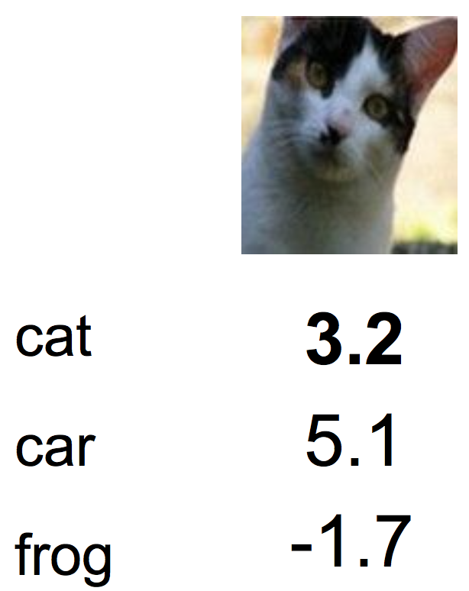
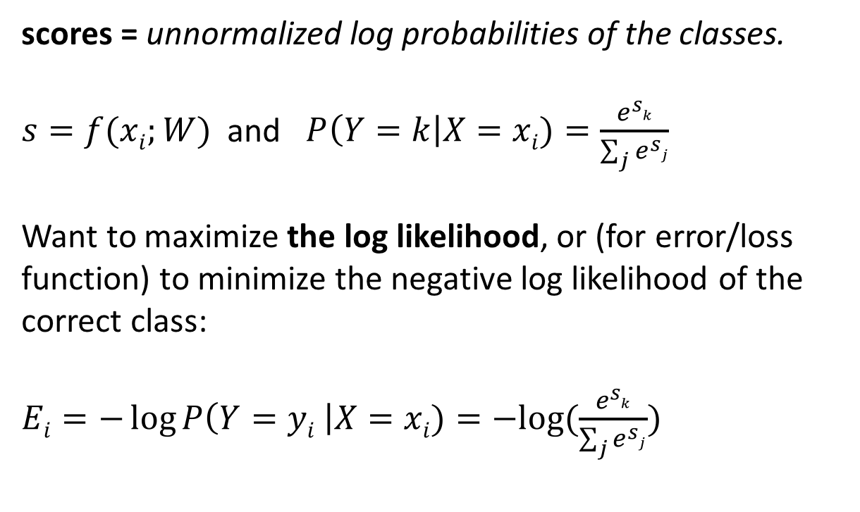
Softmax Classifier
Multinomial Logistic Regression
Softmax
function
Notes:
Ultimately, it depends if you just want a straightforward classifier that separates cars from everything else (SVM) or you want a model that gives your probability for each class (softmax). I find SVM to provide stable results and trains faster while softmax might be bogged down by all the calculations if you have a complex training data with many labels.
There is a major difference between the two, the softmax is a function which is just a generalization of the logistic function, it is used as a cost function for probabilistic multi-class classification, by itself it is not a classifier. It sort of squashes values in a k-dimensional vector to be in the range
^{(0,1)}
⁽
⁰
,
¹
⁾
and sum total of up to 1.0, which gives a probabilistic interpretation thus this is useful as a cost function for multi-class category detection.
An SVM on the other hand is a classifier with a hinge-loss cost function that results in a maximum margin hyperplane. This can be extended to non-linearly separable problems using kernel approaches by mapping the data into higher dimensional spaces.

Slide 25
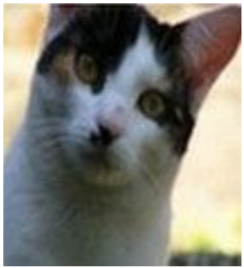
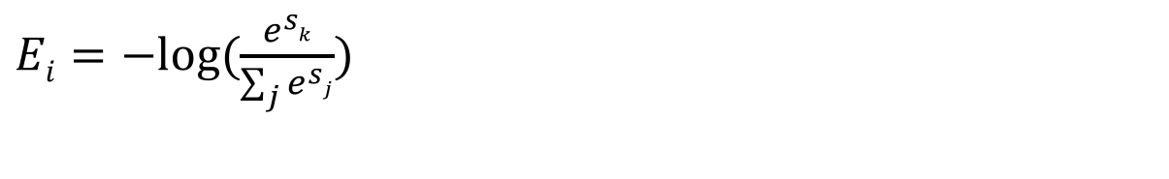
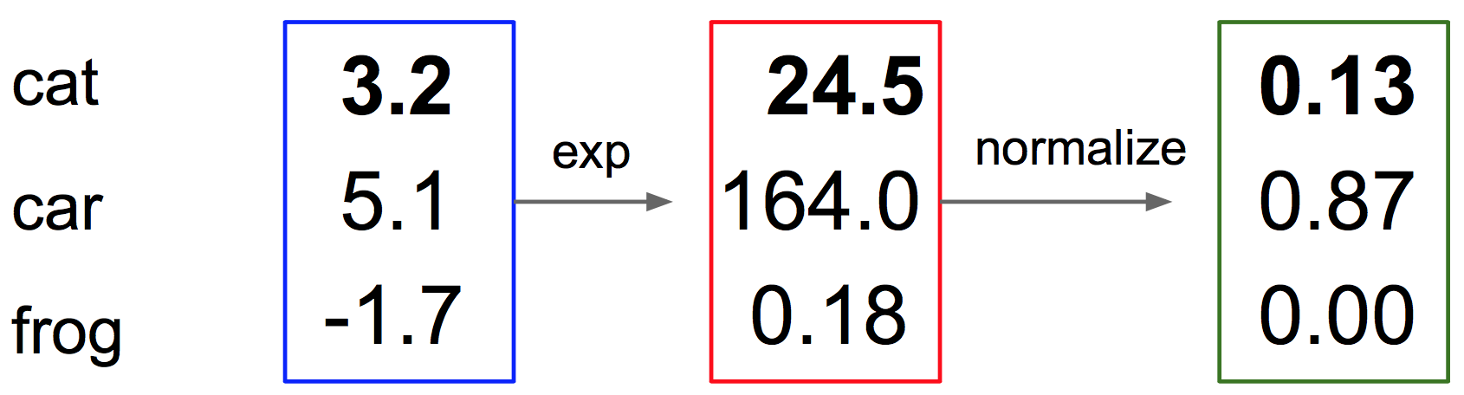
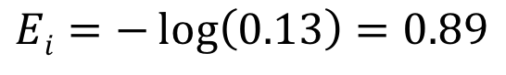
Softmax Classifier
Multinomial Logistic Regression
Softmax
function
Unnormalized Probabilities
Unnormalized Log Probabilities
Probabilities

Slide 26
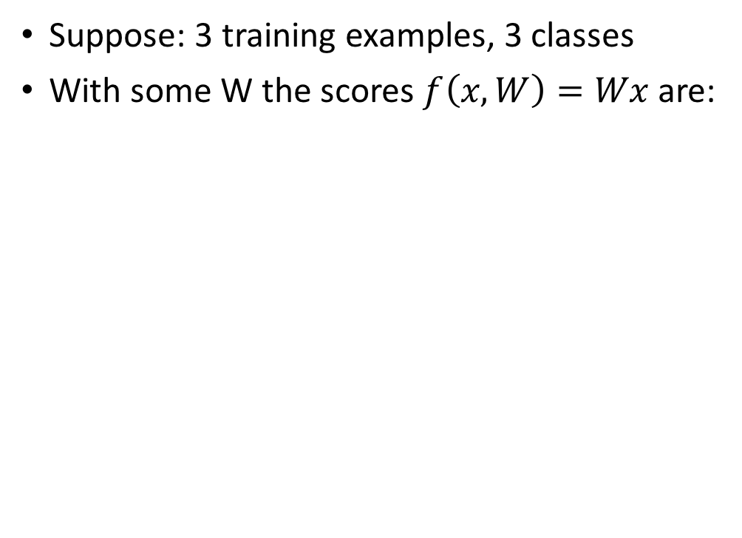
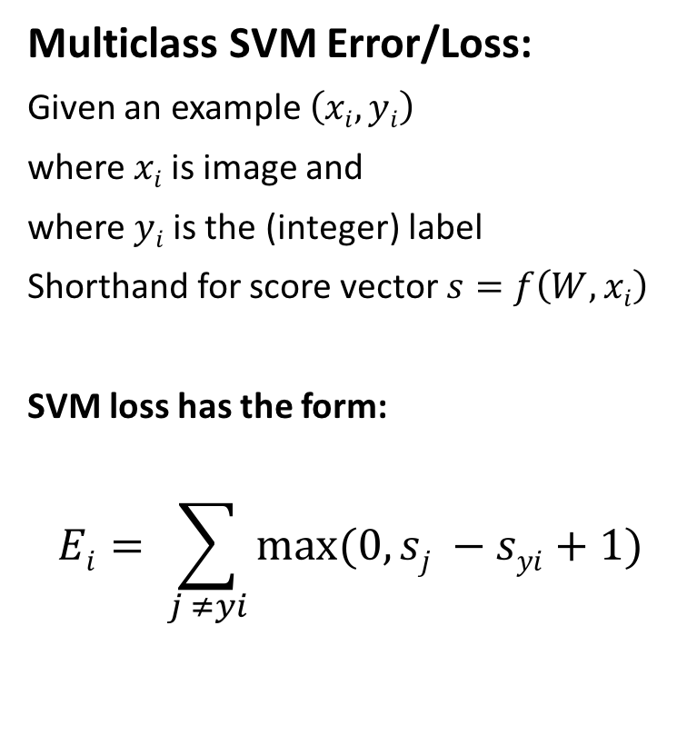
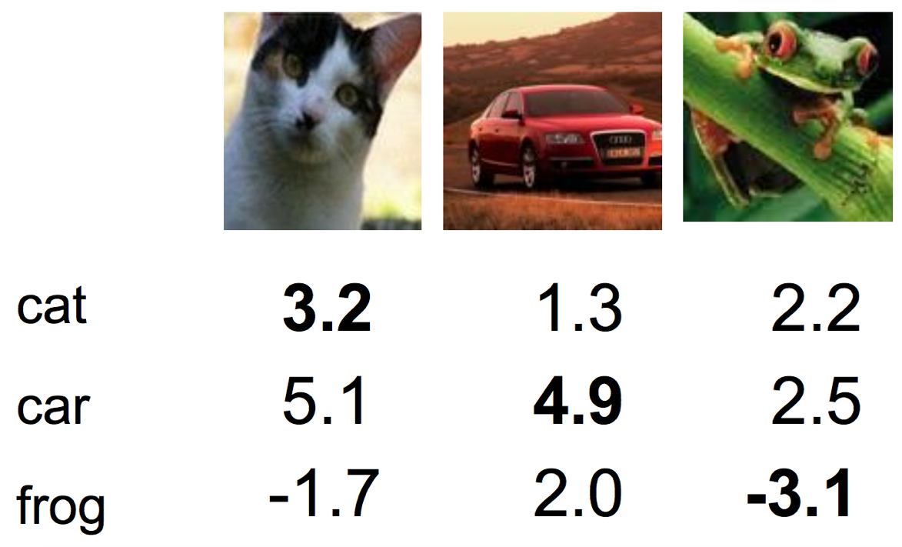
Multiclass SVM Loss

Slide 27
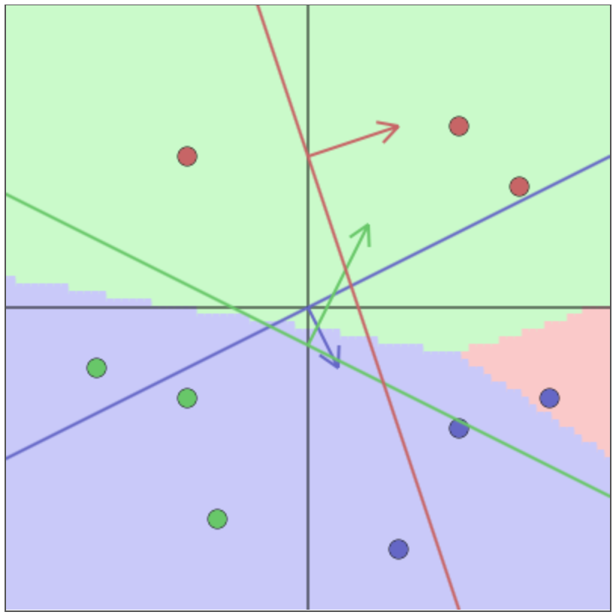
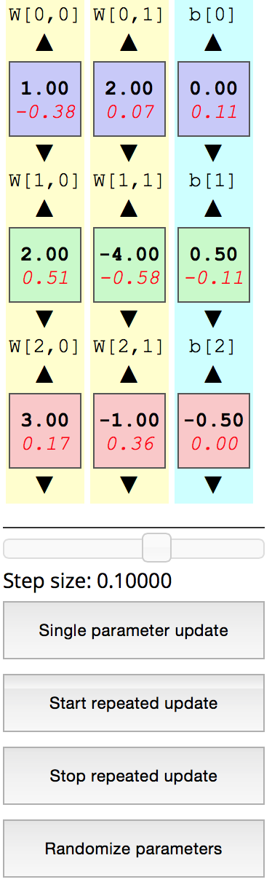
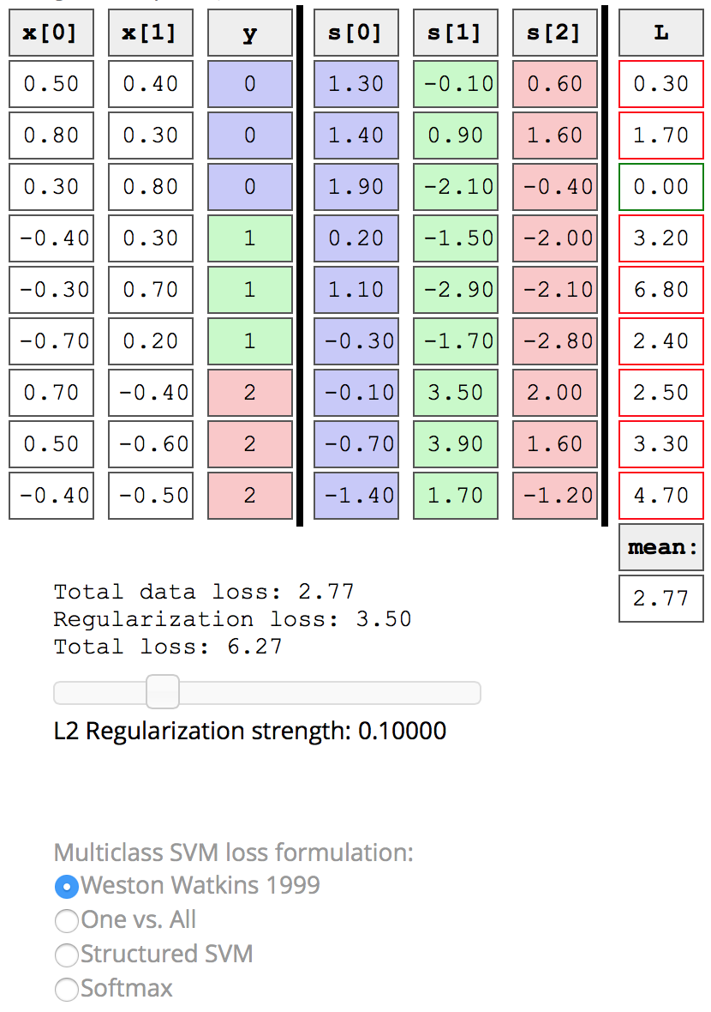
Interactive Web Demo
http://vision.stanford.edu/teaching/cs231n/linear-classify-demo

Slide 28

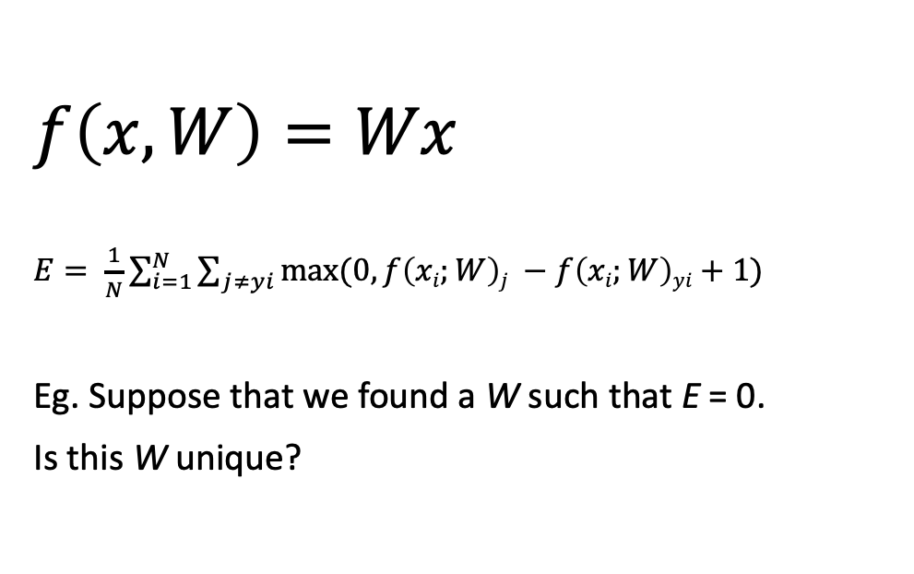
Bugs with Error/Loss

Slide 29
Outline
Understanding Problem
How Neural Network Works
Error / Loss Function
Back Propagation Algorithm
Heuristic Training Dynamic
Implementation
Q&A

Slide 30
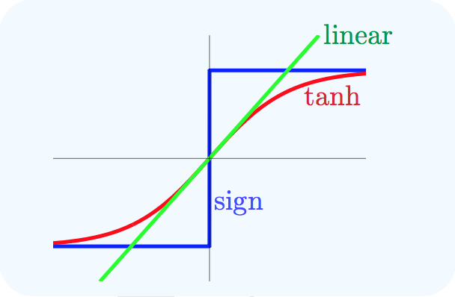
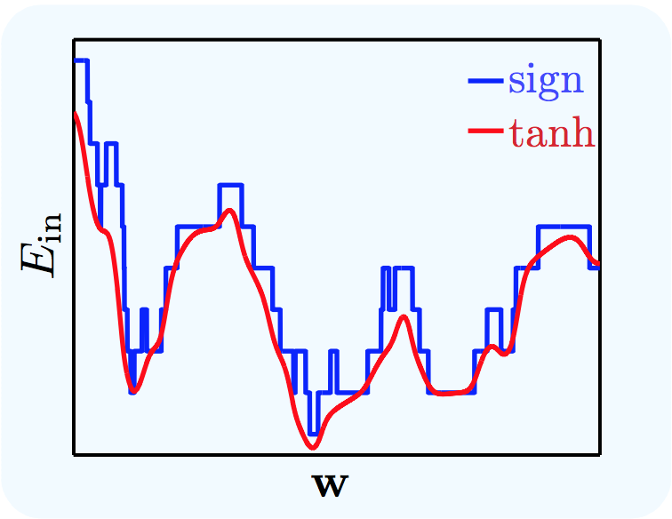
Activation Function Nonlinearity
Using sign(.) turn into hard combinatorial problem, even harder for MLP.
We a need smooth version of sign(.) function, a differentiable approximation to sign(.).
The sigmoidal approximation captures the general shape of the in-sample error E_{in},.

Slide 31
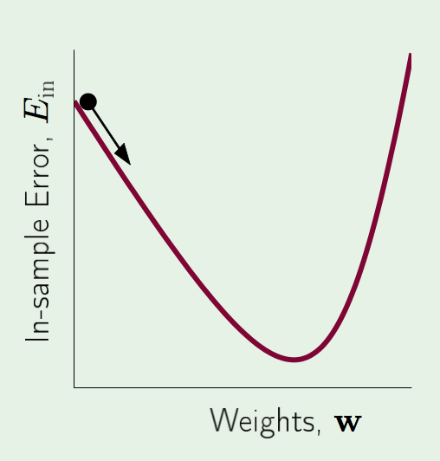
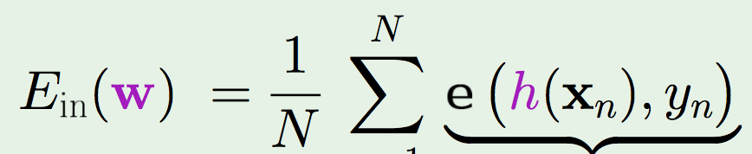
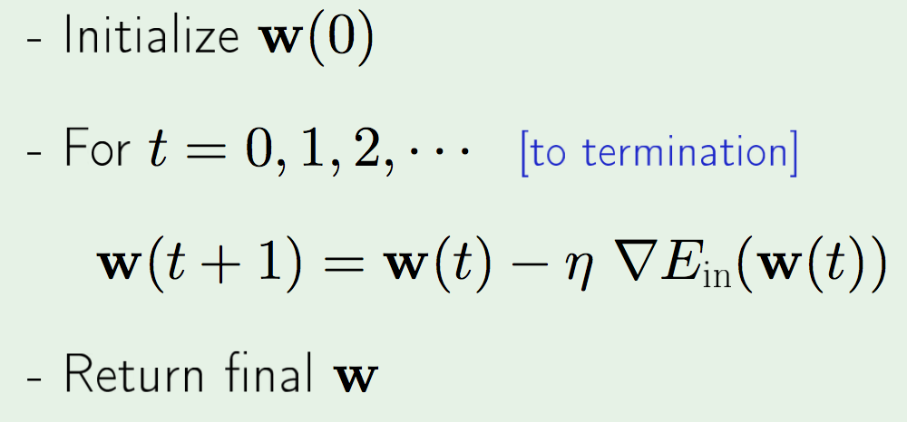
Gradient Descent
In PLA, Gradient Descent is a iterative optimization algorithm to find a local minimum of in-sample error function (E_{in}) or sometime called Cost Function.
GD minimize E_{in} by iterative steps for all examples (x_{n}, y_{n}) and we called it “batch” GD.

Slide 32
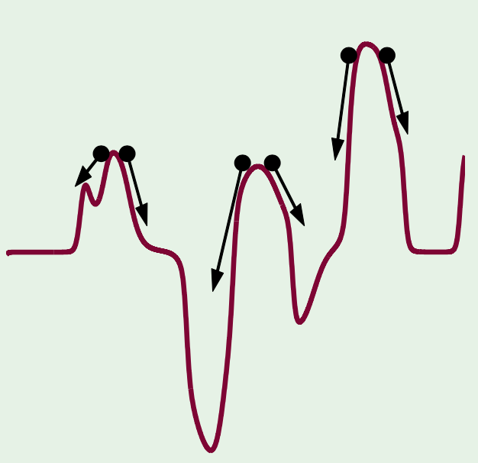
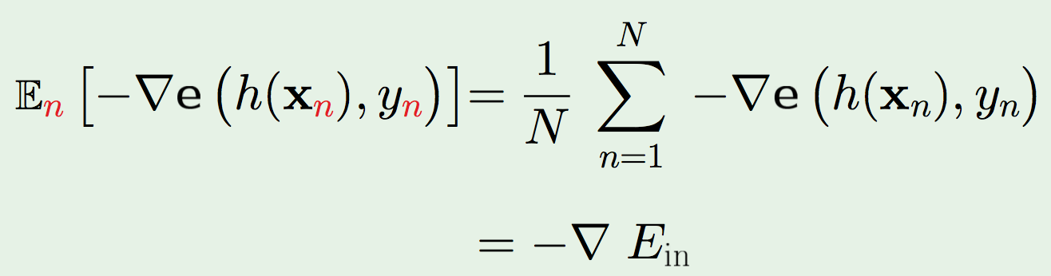
Stochastic Gradient Descent
Stochastic Gradient Descent (SGD), is a stochastic approximation of the gradient descent optimization method for minimizing in-sample error function E_{in} . The method sometime called “mini batch” or a randomized version of GD.
Benefit of SGD: Cheaper, Randomization, Simple
Pick one (x_{n}, y_{n}) at a time. Apply GD to e(h(x_{n}), y_{n})
Use average direction:
Randomization helps to escape local minimums

Slide 33
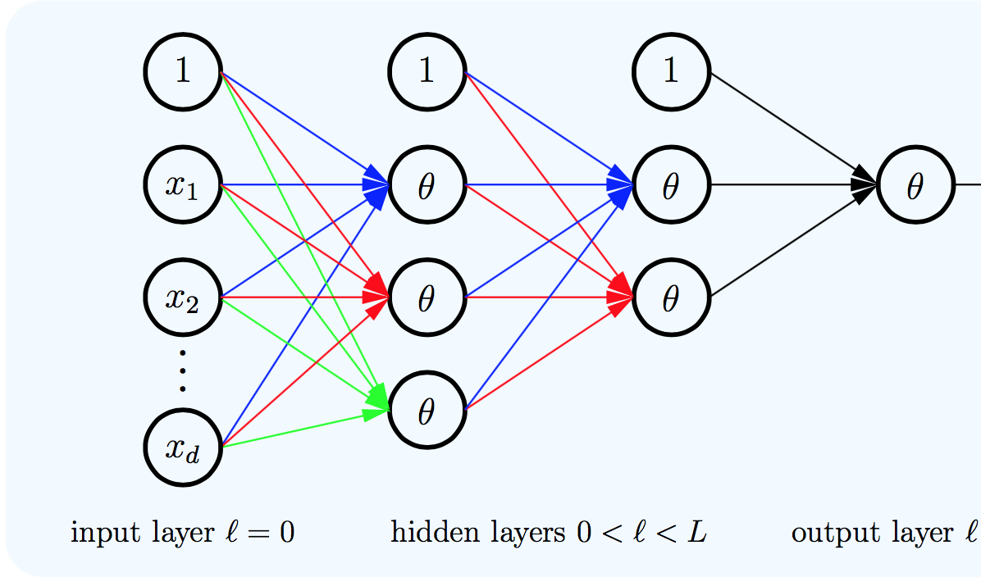
Feed-forward Neural Network
Architecture:
Input Layer
Hidden Layers
Output Layer
One Direction Flow
Deep Neural Networks = Many Hidden Layers
Two Red Flags for Generalization and Optimization

Slide 34
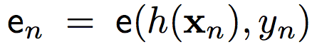
Applying SGD
Problem Statement:
SGD Iteration: where and
Compute h(x) from known w, forward propagation
To compute e we need h(x) and w
To apply SGD we need to know how to compute gradient of e efficiently
What You Have to Know
Formal Notation
Forward Propagation
Back Propagation

Slide 35
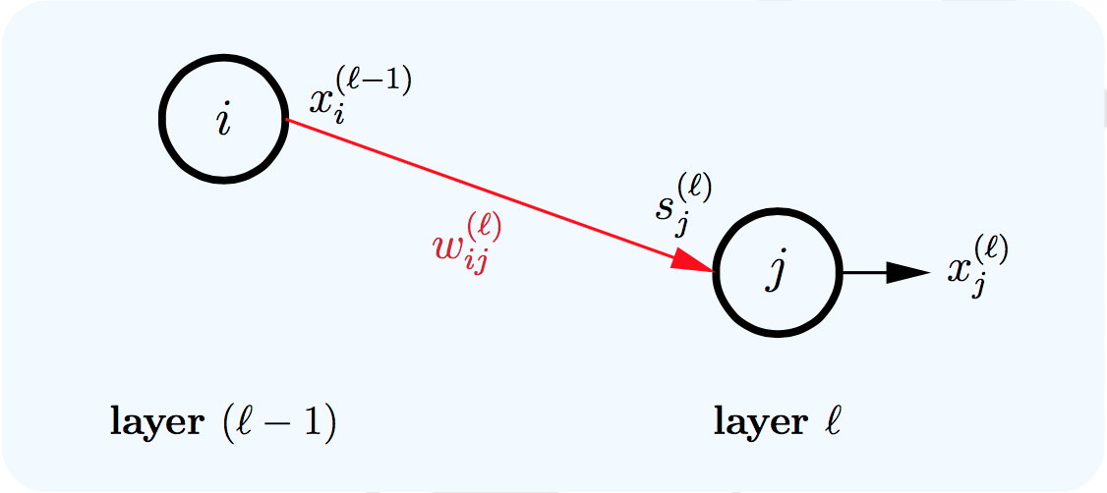
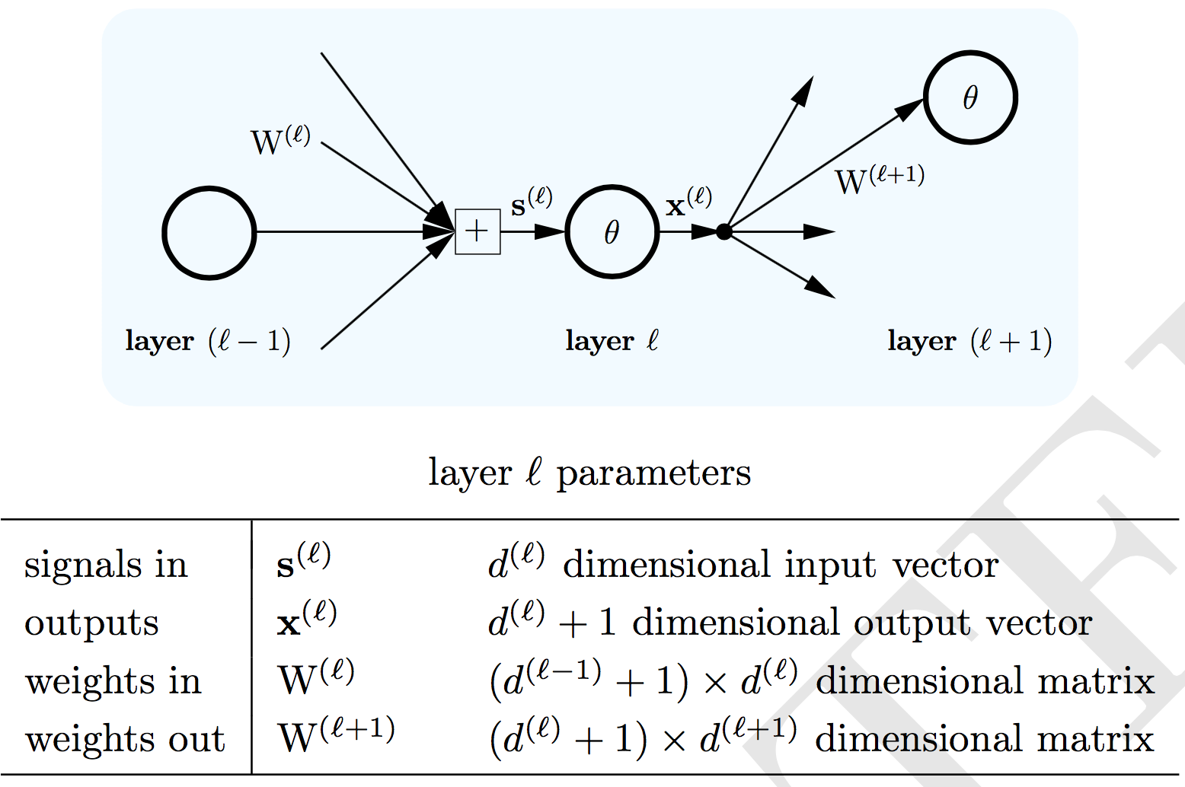
Formal Notation
Conventions:
Layers labeled by l
l = 0 is input
l = L is output
L = number of layers
Each layer l has dimension d
Arrow represent weight
After we fix the weights, we have specified a particular neural network hypothesis h(x, w).

Slide 36
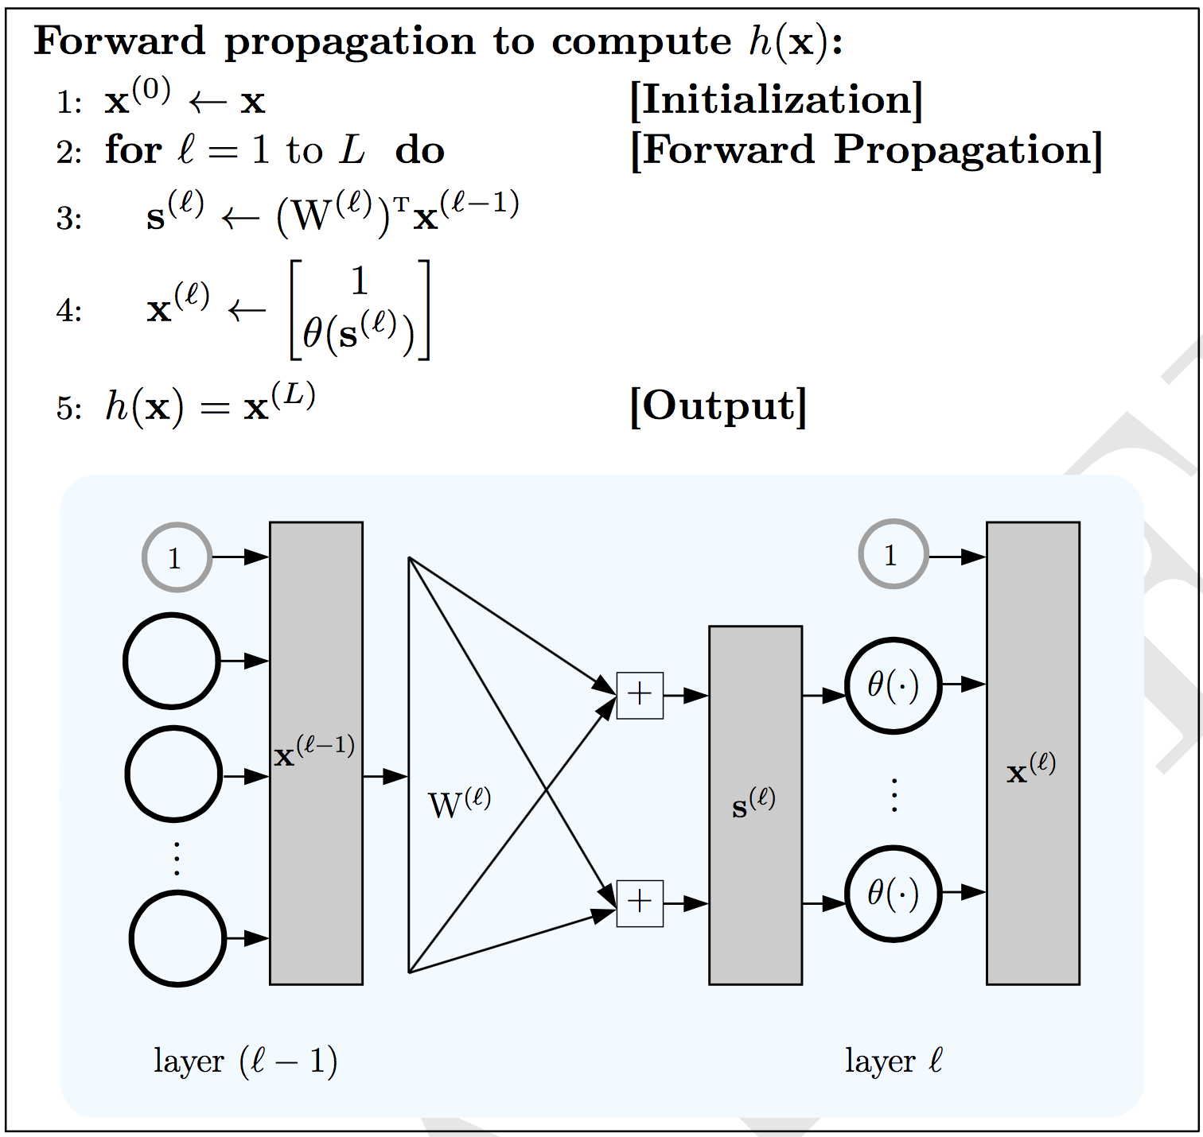
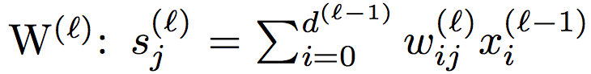
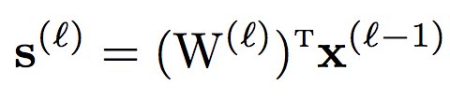
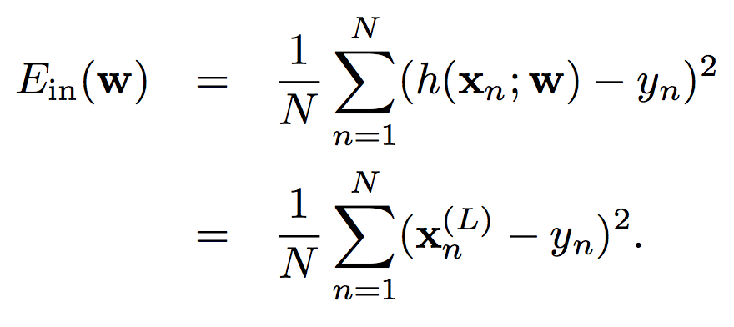
Forward Propagation
Hypothesis h(x) is computed using forward propagation
Compute Weights Matrix:
Compute Error E_{in}(w):

Slide 37
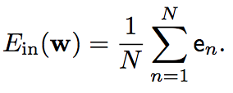

Problem Statement: Compute Gradient
Optimizer Goal: Minimize E_{in}(w) to obtain learned weights.
To compute gradient of E_{in} we need:
Complexity: O(Q²) where Q is number of weights.
Back Propagation: Elegant DP algorithm with O(Q).

Slide 38


Some Definitions
Chain rule for partial derivatives of layer l using partial derivatives of layer (l+1).
Sensitivity vector δ for layer l as gradient of error with respect to input signal s:
Partial derivatives have contributions from two components:
Output vector of the layer from which the weights originate;
Sensitivity vector of the layer into which the weights go;
It turns out that the sensitivity vectors can be obtained by running a slightly modified version of the neural network backwards, and hence the name back propagation.

Slide 39


Essence of Back Propagation
In forward propagation, each layer outputs the vector x^{(l)} and in back propagation, each layer outputs (backwards) the vector δ^{(l)}. In forward propagation, we compute x^{(l)} from x^{(l−1)} and in back propagation, we compute δ^{(l)} from δ^{(l+1)}.
For now, observe that if we know δ^{(l+1)}, then you can get δ^{(l)}. We use δ^{(L)} to seed the backward process, and we can get that explicitly because :
Forward propagation:
Transformation was the sigmoid θ(·)
Back propagation:
Transformation is multiplication by θ′(s^{(l)})
⊗ denotes component-wise multiplication
Notes:
The sensitivity of e to inputs of layer l is proportional to the slope of the activation function in layer l (bigger slope means a small change in s^{(l)} will have a larger effect on x^{(l)}), the size of the weights going out of the layer (bigger weights mean a small change in s^{(l)} will have more impact on s^{(l+1)} ) and the sensitivity in the next layer (a change in layer l affects the inputs to layer l + 1, so if e is more sensitive to layer l + 1, then it will also be more sensitive to layer l).

Slide 40


Back Propagation to Compute δ^{(l)}
Forward propagation:
Compute x^{(l)} for l = 0,...,L
Back propagation:
Compute δ^{(l)} for l = 1,...,L
for l = L:
Recursively we can see:

Slide 41





Calculus of Back Propagation
If you trust math, you can skip this ☺. Let see:
Chain of dependencies:
Chain rule:

Slide 42


Summary of Back Propagation
Setup network architecture & hyper parameters
Compute x^{(l)} using forward propagation
Compute sensitivities δ^{(l)} using back propagation
Compute in-sample error and gradient on data point x_{n} as G^{(l)}(x_{n})

Slide 43
Agenda
Understanding Problem
How Neural Network Works
Error / Loss Function
Back Propagation Algorithm
Heuristic Training Dynamic
Implementation
Q&A

Slide 44

Training Deep Neural Networks
Software Packages
One Time Setup
Activation Functions
Data Preprocessing
Weight Initialization
Regularization
Gradient Descent Optimizers
Training Dynamics
Babysitting the Learning Process
Monitor and Visualize
Learning Rate Schedules
Hyperparameter Optimization
Evaluation
Model Ensembles
Heuristics
Mini-Batch SGD Loop:
Sample a batch of data
Forward prop it through the network
Get the loss / in-sample error
Backprop to calculate gradient
Update parameters using gradient

Slide 45


Overfitting Problem
Overfitting : the downside of complex model
Training data contains two type of noise:
Unreliable target values
Sampling error
When we fit the model, it cannot tell which regularities are real and which are caused by sampling error.
Which model we trust?
Complicated model?
Simple model?
If the model is very flexible it can model the sampling error really well. This is a disaster.
Output = y
Input = x
Which output value should you predict
for this test input?

Slide 46

How to Handle Overfitting
Many Techniques Available
Get more data
Use right capacity model
Weight-decay / regularization
Weight-sharing
Early stopping
Model averaging
Bayesian fitting of neural nets
Dropout
Generative pre-training
Limit the size of weights by penalizing large weights using penalties or constraints on their squared values (L2 penalty) or absolute values (L1 penalty).

Slide 47

Weights Initialization
Initial Question: What happen when W = 0 init is used?
First idea:
Small random numbers (gaussian with zero mean and 0.01 sd)
Works ~okay for small networks, but can lead to non-homogeneous distributions of activations across the layers of a network.
Proper Initialization is active area of research:

Slide 48



Regularization

Slide 49


Weight Regularization
Regularization Strength
Notes:
The standard L2 weight penalty involves adding an extra term to the cost function that penalizes the squared weights.
Effect of L2:
L2 keeps the weights small unless they have big error derivatives.
It prevents the network from using weights that it does not need.
– This can often improve generalization a lot because it helps to stop the network from fitting the sampling error.
– It makes a smoother model in which the output changes more slowly as the input changes.
• If the network has two very similar inputs it prefers to put half the weight on each rather than all the weight on one.
Sometimes it works better to penalize the absolute values of the weights (L1).
– This can make many weights exactly equal to zero which helps interpretation a lot.
Sometimes it works better to use a weight penalty that has negligible effect on large weights.
– This allows a few large weights.

Slide 50


Regularization (Dropout)
Randomly set some neurons to zero in the forward pass.
Monte Carlo Approximation: do many forward passes with different dropout masks, average all predictions.
How could this possibly be a good idea?
Srivastava et al., 2014
Notes:
Another interpretation:
Dropout is training a large ensemble of models (that share parameters).
Each binary mask is one model, gets trained on only ~one datapoint.
Ideally: want to integrate out all the noise
Monte Carlo approximation:
do many forward passes with different dropout masks, average all predictions

Slide 51
Agenda
Understanding Problem
How Neural Network Works
Error / Loss Function
Back Propagation Algorithm
Heuristic Training Dynamic
Implementation
Q&A

Slide 52


Introduction to TensorFlow
Tensor
Definition: An array with more than two axes
Arbitrary dimensionality array
Directed Graph
Used describes computation
Node: Instantiation of an operation
Operation
An abstract computation
Have attributes
Kernel
Particular implementation of an operation
Run on a type of device (e.q. CPU, GPU)
Variable
Special operation to persistent mutable tensor
Session
Created to interact with TensorFlow system
Download at www.tensorflow.org

Slide 53


Activation Functions
Smooth Nonlinearities:
Sigmoid
Tanha
Elu
Softplus
SoftSign
Continuous Differentiable:
ReLu
Relu6
CreLu
Relu-X
Random Regularization:
Dropout

Slide 54
TensorFlow Activation Functions
Smooth Nonlinearities:
Sigmoid
Tanh
Elu
Softplus
SoftSign
Continuous Differentiable:
ReLu
Relu6
CreLu
Relu-X
Random Regularization:
Dropout

Slide 55
How to Choose Activation Function
Sigmoid. Historically popular since they have nice interpretation as saturating “firing rate” of a neuron.
(-) Saturated neurons kill gradients.
(-) Sigmoid outputs are not zero centered.
(-) Exponential is expensive computation.
Tanh. Still kill gradients when saturated.
ReLU (Rectifier Linear Unit).
(+) Doesn’t saturate (in +region).
(+) Computationally efficient.
(+) Converges faster than sigmoid/tanh in practices (e.g.6x)
(-) Not zero centered output.
Leaky ReLU. All benefits of ReLU but better. It will not “die”.
ELU. All benefits of ReLU. Doesn’t die. Closer to zero mean outputs.
Maxout Neuron. All benefits of ReLU and Leaky ReLU but doubles the number of parameters.
RECOMMENDATION:
Use ReLU. Be carefull with learning rate.
Try out Leaky ReLU / Maxout / ELU.
Try out tanh but don’t expect much.
Don’t use sigmoid.

Slide 56


TensorFlow Optimizers
Gradient Descent Variants:
Batch, Stochastic, Mini-Batch
Gradient Descent Optimization Algorithms:
GD: Basic Gradient Descent Algorithm
AdaDelta: Ada Delta Algorithm
AdaGrad: Adaptive Subgradient Algorithm
AdaGradDA: Adagrad Dual Averaging Algorithm
Momentum: SGD Momentum Algorithm
Adam: Adam Algorithm
FTRL: FTRL Algorithm
RMSProp: RMSProp Algorithm
Papers listed in TF documentation
Notes:
URL: http://sebastianruder.com/optimizing-gradient-descent/index.html

Slide 57


Data Preprocessing
Normalization
PCA and Whitening
Note: We will have session about this!

Slide 58
Babysitting the Learning Process
Pre-process the data
Choose network architecture (DNN, CNN, RNN, etc)
Double check the cost/loss is reasonable
Adjust regularization (L1, L2, etc)
Find learning rate that makes loss down
If loss not going down or barely changing, learning rate too low
If loss exploding, learning rate too high
Monitor and visualize loss curve
Monitor and visualize accuracy

Slide 59

Monitoring Loss Values

Slide 60

Monitor and Visualize Accuracy

Slide 61

Hyperparameter Optimization
Coarse-Fine Cross Validation Strategy
First stage: only a few epochs to get rough idea of what params work
Second stage: longer running time, finer search …. (repeat as necessary)
Hyperparameters to play with:
Network Architecture
Learning Rate, Its Decay Schedule, Update Type
Regularization (L2/Dropout Strength)
Notes:
Random Search for Hyper-Parameter Optimization, Bergstra and Bengio, 2012

Slide 62
Gradient Descent Optimizers
Gradient Descent Variants:
Batch, Stochastic, Mini-Batch
Gradient Descent Optimization Algorithms:
GD: Basic Gradient Descent Algorithm
AdaDelta: Ada Delta Algorithm
AdaGrad: Adaptive Subgradient Algorithm
AdaGradDA: Adagrad Dual Averaging Algorithm
Momentum: SGD Momentum Algorithm
Adam: Adam Algorithm
FTRL: FTRL Algorithm
RMSProp: RMSProp Algorithm
Papers listed in TF documentation. Adam is good default choice.
Read More: Gradient Descent Optimization Algorithms
Notes:
URL: http://sebastianruder.com/optimizing-gradient-descent/index.html

Slide 63


Choosing Learning Rate
All optimizers all have learning rate as hyperparameter.
Learning rate decay over time.
We have to try the learning rate values.
Which one of these learning rates is best?
Find the good learning rate. Read more papers.

Slide 64

Neural Network Playground

Slide 65


What The Theory Tell Us

Slide 66

Home Work
Please reproduce Chapter 3 and 4 of www.d2l.ai

Slide 67
Q&A
Understanding Problem
How Neural Network Works
Error / Loss Function
Back Propagation Algorithm
Heuristic Training Dynamic
Implementation
Q&A

